Slide 1
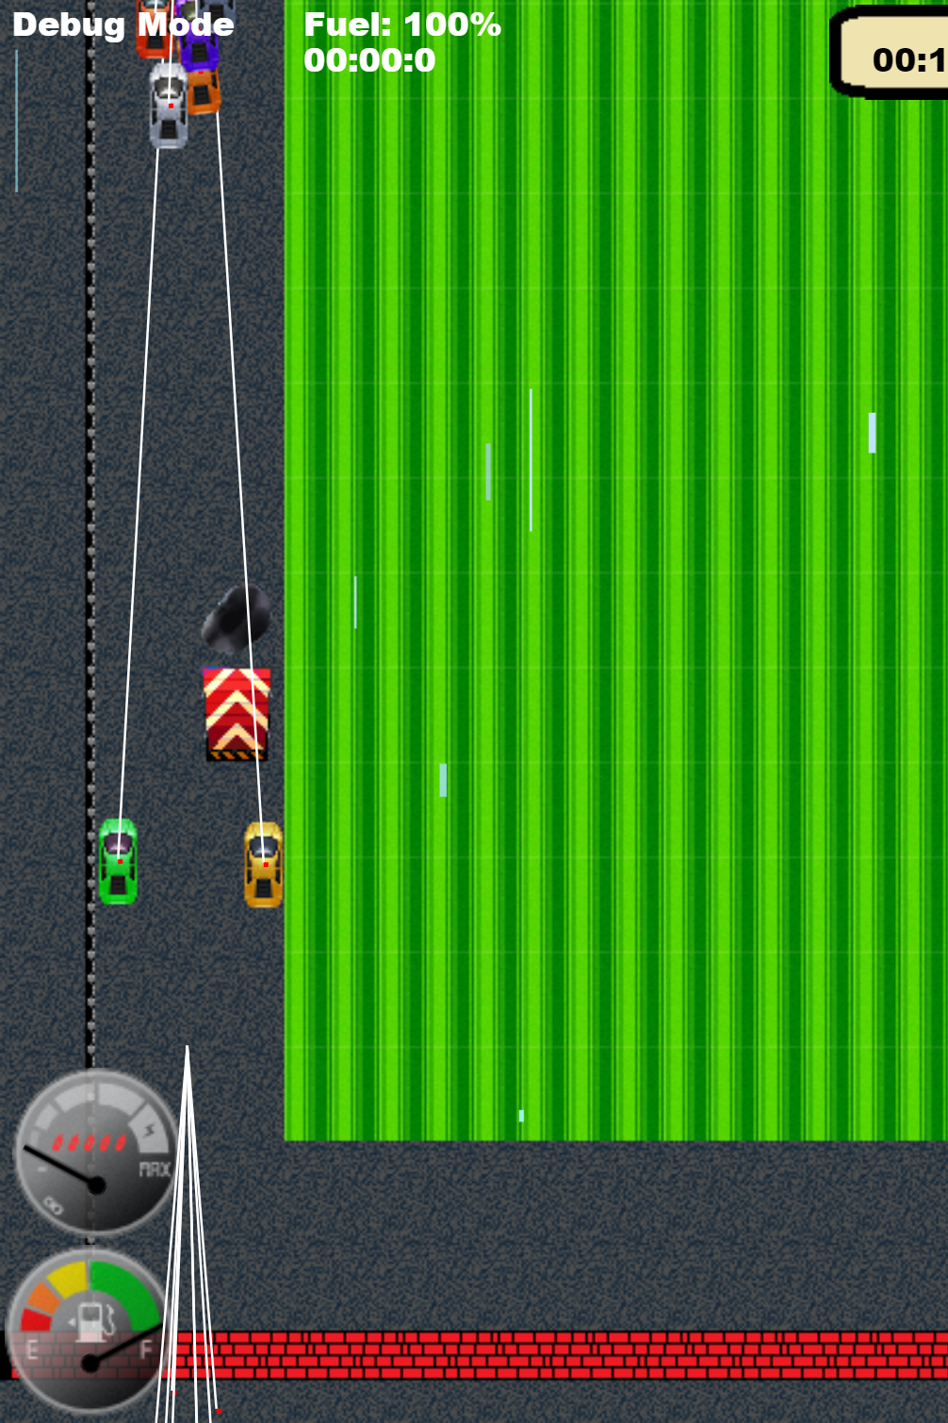
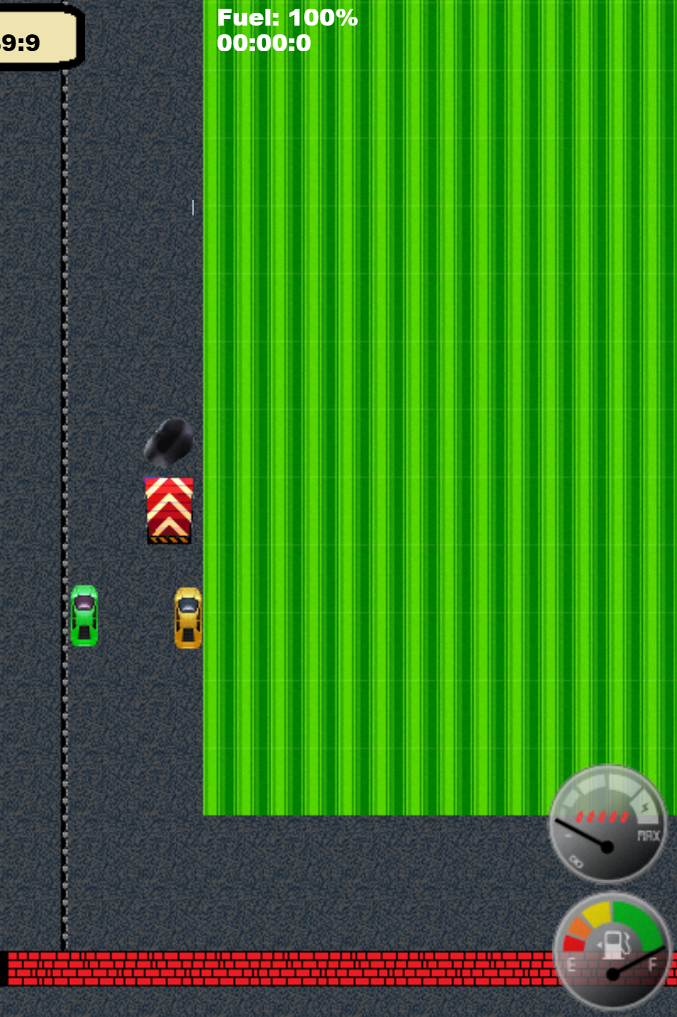
Little Racers
Pitch Date: June 22 , 2019 Week 4: 7/21/2019
Release Date: September 15, 2019 8 weeks to go!
Team Lead: Vince McKeown
17 contributors (+3)

Slide 2
Updates to Code
Mike LeSauvage
Balanced car parameters for engine and transmission upgrades
Refactored meters and gauge scaling.
Nitro gauge implemented
Vince McKeown
AI for slowing down vehicles when approaching another vehicle
Simon
Screen Shake
Muted Music Option
Michelly-Oliveira
Correction to purchasing
Added Transmission Options
Low Fuel Warning

Slide 3
Updates to Code
Anthony Free
Fuel Efficiency can be set/upgraded
Cars have shields/health
Car refuels at pitstops
Terrence McDonnell
Waypoint integration (Racing and finishing)
Fixed Win Screen
H Trayford
Added Way Points to Big Track
Created Debug Option to scroll camera
Randy Tan Shaoxian
Created Checkpoint arrows for missed checkpoints
Adjusted CSS scaling
Refactored Fuel and Speedometer gauge

Slide 4
Updates to Code
Jeff Hanlon
Created name handling (car names, sounds, winning)
Baris Koklu
AI for car braking on turns
Christer “McFunky Pants” Kaitila
Added Smoke and Fire!
Back To the Future feel to Title Screen

Slide 5




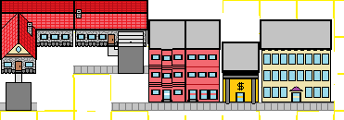
Updates to Art
Jeff Hanlon
Christer “McFunky Pants” Kaitila
H. Trayford
Vince McKeown

Slide 6
Updates to Sound
Alan Z
Updates to Background Music
Jeff Hanlon
Added driver names
Puggington
McFirePants
Luminous Thunder
Max Mad
Chris Delorean
Spectre
Mach
Easter Egg Sounds
Puppy Go

Slide 7
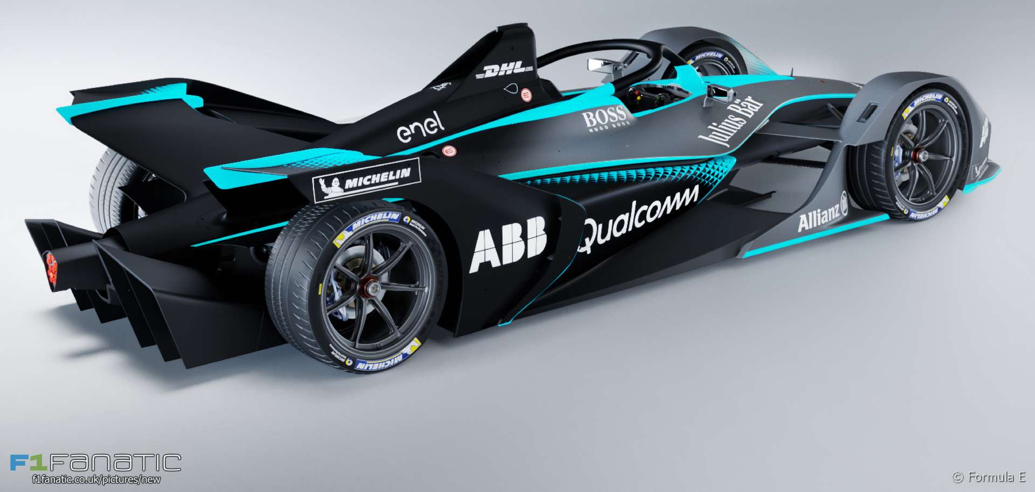
Demo
Cutover to Game

Slide 8
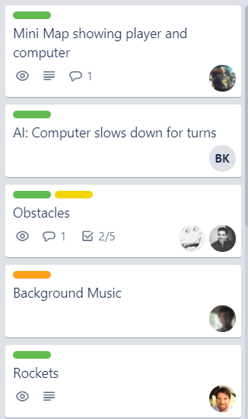
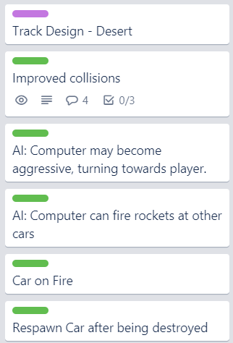
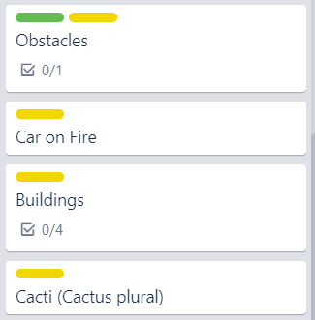
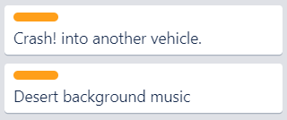
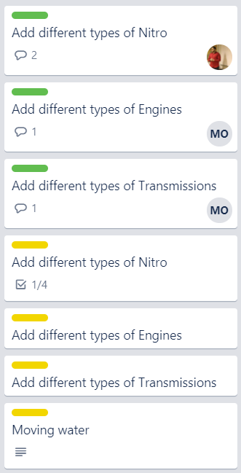
Week 4 Schedule
Committed
Code
Artwork
Sound
Warm Up

